Slide 1
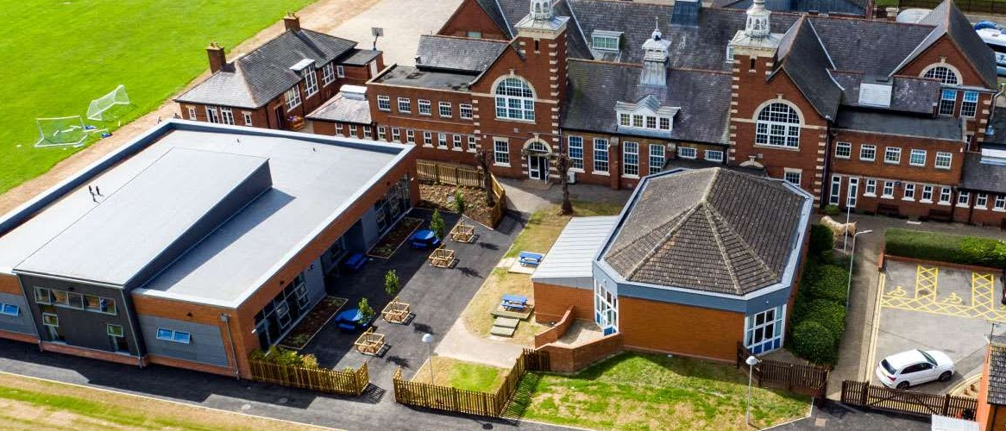

Maths at Bushfield
Information for Parents

Slide 2
Contents
Maths:
Sample questions
Maths homework
Curriculum & skills

Slide 3
Curriculum & Skills
Our Maths Curriculum covers the KS2 program of study as outlined by the National Curriculum.*
The aim of the National Curriculum is to ensure that all pupils become fluent in the fundamentals of mathematics, reason mathematically and can solve problems. At Bushfield, we ensure we progress skills appropriately, using the guidance of the Curriculum and developed within each Year group within the following main areas of maths:
Number and Place Value
Calculation
Measure
Algebra (Year 6 but introduced discreetly prior).
Fractions
Ratio and Proportion
Geometry
Statistics
*Useful links: https://assets.publishing.service.gov.uk/government/uploads/system/uploads/attachment_data/file/335158/PRIMARY_national_curriculum_-_Mathematics_220714.pdf

Slide 4

When is Maths taught?
Each child completes a minimum of four 1 hour lessons of maths per week which are planned and organised to best support their age and ability.
In addition to this, we have a 30 minute dedicated calculation and reasoning lesson per week to ensure explicit repetition of the four operations and time to work on how we represent, explain, develop and discuss maths questions (reasoning).
Maths comes into many areas of learning across the curriculum and we encourage children to see links across their learning in different subjects in addition to their specific Maths lessons.

Slide 5
Times Tables
Times table practice is incorporated into our curriculum wherever possible as they underpin many elements within maths.
We know times table knowledge helps to support with children’s understanding and working at a greater depth within mathematics and therefore we highlight how important learning them is to all pupils.
The national expectation is that all pupils should know all their times tables up to 12 x 12 by the end of Year 4.
There is now a statutory times table assessment called, ‘The multiplication tables check’ (MTC) for primary schools. The purpose of the MTC is to determine whether pupils can recall their times tables fluently, so that additional support can be provided to those who have not.
We use many different strategies to teach times tables such as:
  Rote learning
  Times table games
  Times tables Sing Alongs
  Times Table Rockstars for daily homework practice along with class battles
  We also celebrate achieving times table success with our specific timetable certificates that the children are tested for across the school year.

Slide 6

Written Methods
Written methods cover the 4 operations:
  Addition
  Subtraction
  Multiplication
  Division
These methods are introduced and taught age appropriately following the National Curriculum’s expectation of which methods should be used.
These methods are adapted as needed to support the learning of our children using our Written Method Policy to ensure a consistent approach is used with your children across Wyvern and Bushfield.

Slide 7
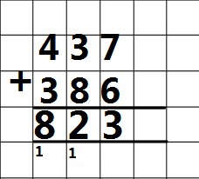
Addition and Subtraction
The Column Method examples
7 add 6 equals 13. Write down 3 and carry the ten. Write down the tens digit in the ‘Tens’ column.
30 plus 80 equals 110. Add the extra ten and that equals 120. Write down the twenty (2 digit in the tens column) and carry 100. Write the hundreds digit under the ‘Hundreds column’.
400 plus 300 equals 700. Add the extra 100 and that equals 800.
The total is eight hundred and twenty three.

Slide 8
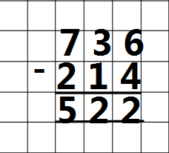
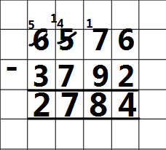
Addition and Subtraction
Example 1- numbers that don’t require exchanging.
Example 2- numbers that require exchanging.
6 subtract 2 equals 4.
70 subtract 90 can’t be done because 90 is larger than 70. Take one lot of 100 from the ‘Hundreds’ column (500 now becomes 400) and add this to the 70 to make 170. 170 – 90 = 80*
400 - 700 can’t be done because 700 is larger than 400. Take one lot of 1000 from the ‘Thousands’ column (6000 now becomes 5000) and add this to the 400 to make 1400. 1400 – 700 = 700. 5000 – 3000 = 2000

Slide 9
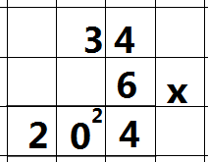
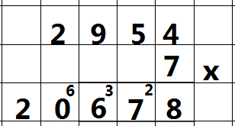
Short multiplication
(any number multiplied by a single digit number)
4 multiplied by 6 = 24. Write the 4 in the ‘Ones’ column and carry the two into the ‘Tens’ column.
30 x 6=180 but we write this as three x 6 (18) and add the 2 ( that represent 20) from the 24 which makes 200. We write this as 20.
We can now see the answer as 204.

Slide 10
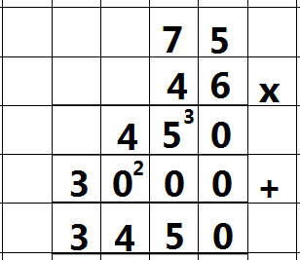
Long multiplication (by two digit)
Complete the top row by the ‘Ones’ column as we did for short multplication. ( 75 x 6).
For the ‘Tens’ column, we place a 0 to represent that the ‘4’in 46 represents 40. We then complete as we did for the short multiplication method.
Finally we add up the total.

Slide 11
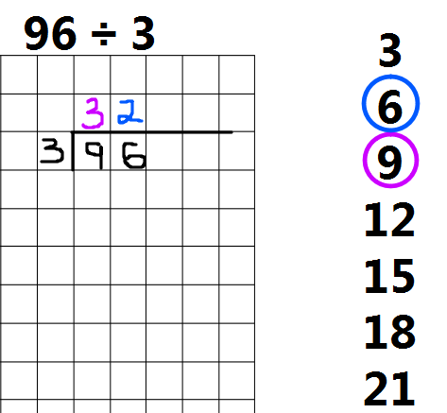
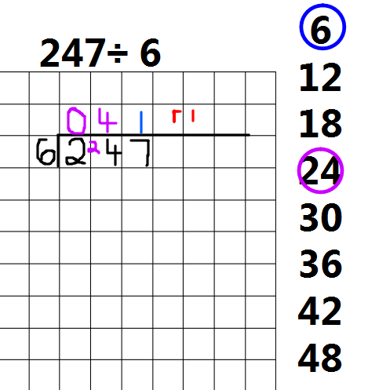
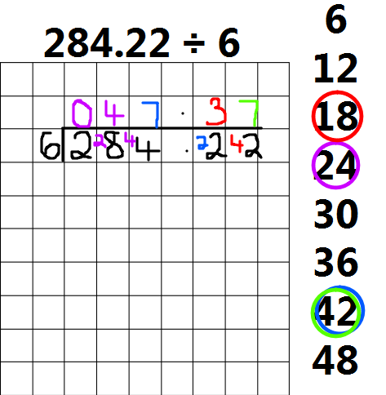
Short division method
(any number divided by a single digit number).
Children will progress from the initial short division method without remainders, to remainders and then as they reach Year 5 and 6 they will begin to express remainders as fractions and decimals.
For 96 divided by 3, We look at how many times the divisor (3) goes into the dividend (96).
3 goes into 9, three times exactly so we place the three above. There is no remainder.
3 goes into 6, 2 times exactly so we write this above.

Slide 12
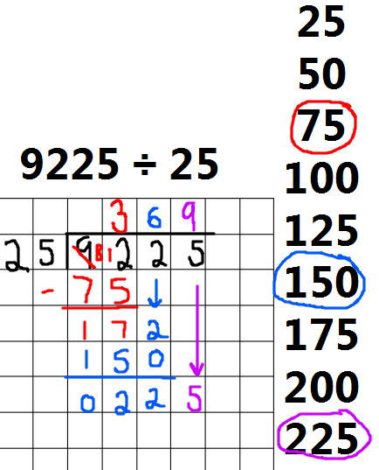
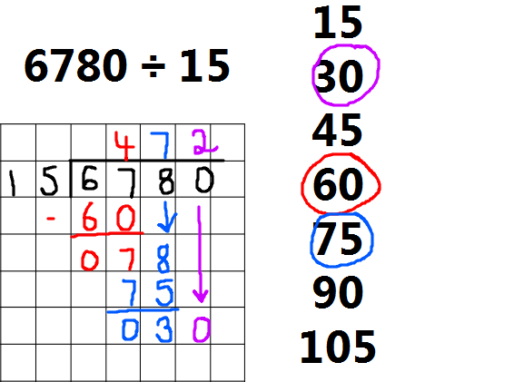
Long division
A number up to four digits (or more) divided by two digits
(Year 6 only)

Slide 13
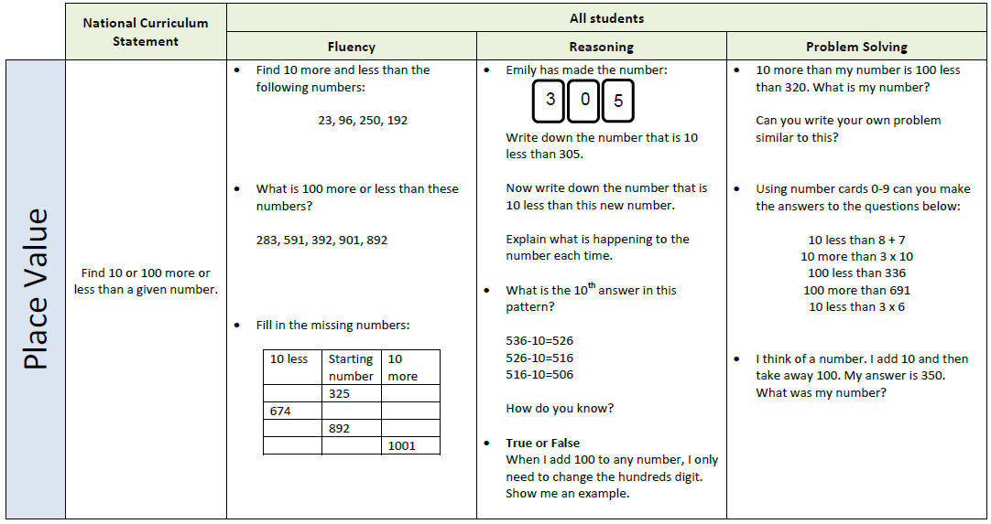
Reasoning examples
Key skill

Slide 14

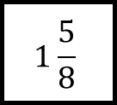
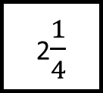
Example of a Year 6 SATs question
Reasoning – multiple step, multiple application problems.
The numbers in this sequence increase by the same amount each time.
Fractions
Common
denominators
Mixed numbers /Improper fractions
Sequences
Write the missing numbers.
1
$$1\frac{5}{8}$$
2$\frac{1}{4}$

Slide 15
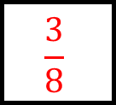
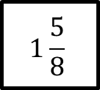
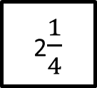
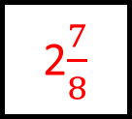
Reasoning – multiple step, multiple application problems.
The numbers in this sequence increase by the same amount each time.
Fractions
Common
denominators
Mixed numbers /Improper fractions
Sequences
Write the missing numbers.
$$\frac{3}{8}$$
1
$$1\frac{5}{8}$$
2$\frac{1}{4}$
2$\frac{7}{8}$

Slide 16
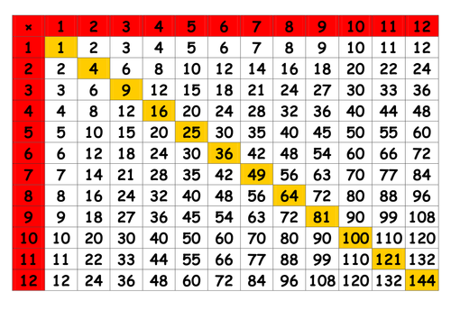
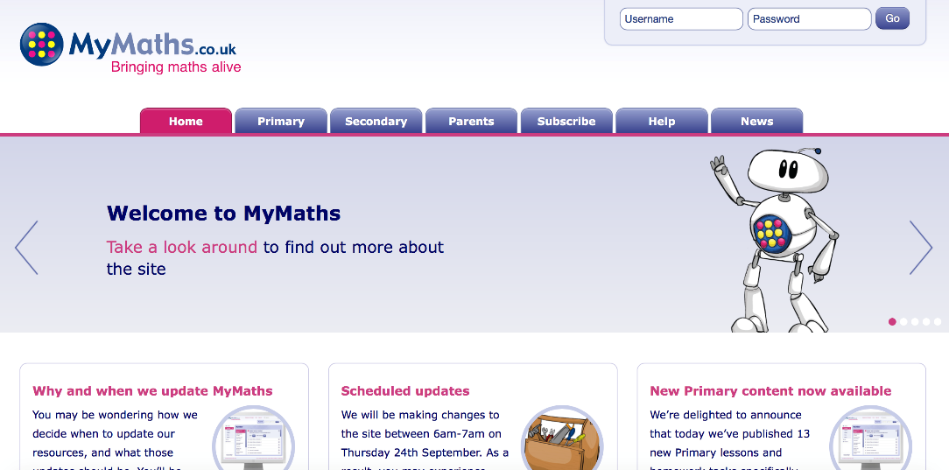
Homework
Your child will be set one piece of weekly Maths homework that should take approximately 40 minutes to complete. Usually this is set on MyMaths.
In addition to this, your child should practise times tables (ideally daily). Your child can do this on Timetables Rockstars but any form of practise is fine.
Times Tables Rockstars
https://ttrockstars.com/
Weekly times tables task
MyMaths
https://www.mymaths.co.uk/
All relevant passwords and usernames are recorded in your child’s log book for easy reference.

Slide 17

How can you help your child?
Number sense:
  Times tables
  Number bonds/basic facts
Telling the time
Word problems in contexts – focusing on language
Homework
Times Table Rockstars
https://ttrockstars.com
At home access to Hit the Button - https://www.topmarks.co.uk/maths-games/hit-the-button
YouTube link for times tables video – Learn the fun way (aimed at Y3/4 but fun for all!)
https://www.youtube.com/watch?v=lUIB-dZRCiA

Slide 18
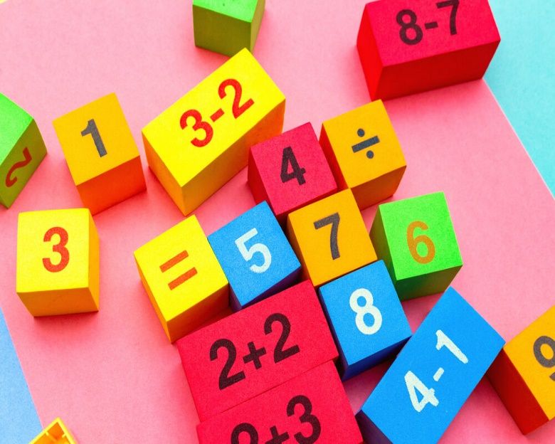
What to do if you are worried about your child’s Maths
We recognise the importance of maths skills for further education success and in life, and are committed to achieving the best for all pupils.
We use a multitude of different strategies and resources to support children in school but if you are worried about your child’s progress as with any subjects, please don’t hesitate to contact your child’s teacher.

Slide 19
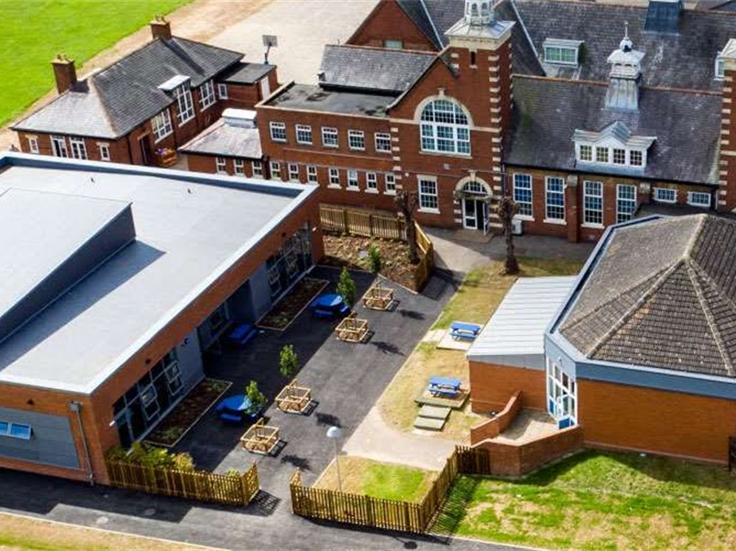
Thank you for your support

